Slide 1
Flower classification
Liu Yingjie 20711100
Huang Luyu 20721052
Gao Wanqi 20733691
Wang Ruoyu 20733823
Xie Chongshan 20755209

Slide 2
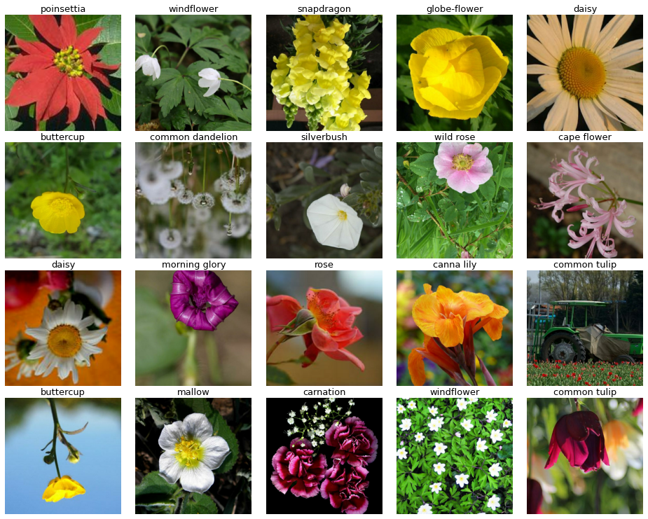
Problem background
There are many kinds of flowers in nature, and we want to use machine learning tool to identify them automatically
Existing application: wechat mini-program 识花君

Slide 3

Dataset
12753 training images, 3712 validation images, 7382 unlabeled test images
Each data item is a 512*512*3 image with a numeric label (no label for testing data)
TFRecord format, a container format frequently used in Tensorflow for optimal training performance.

Slide 4
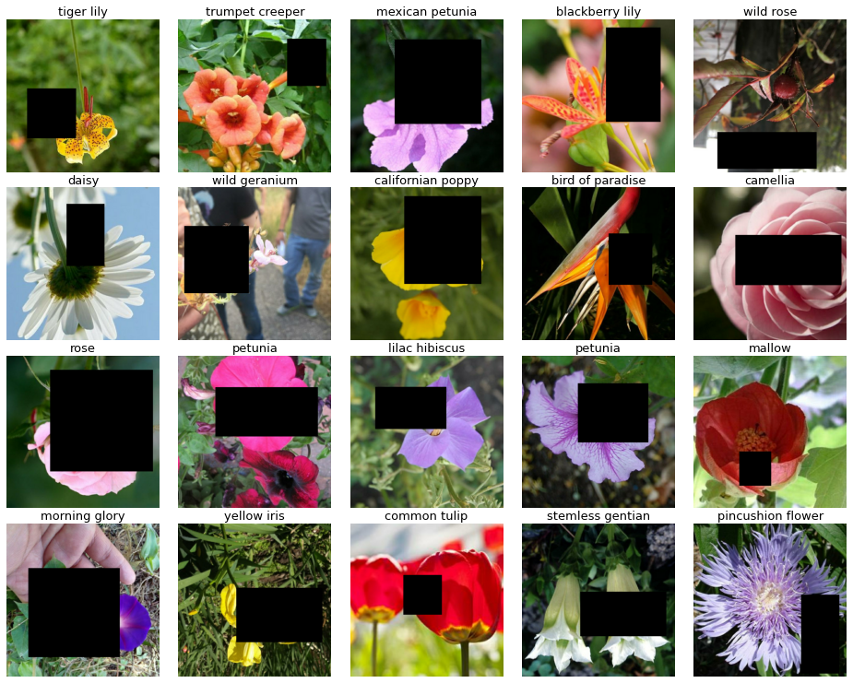
Data preprocessing
Random flipping (no big effect)
Crop and resize (not good)
Random blockout (seems good)
Model: DenseNet201 | Train – Val Accuracy
Before blockout | 0.74 – 0.83
After blockout | 0.72 – 0.85

Slide 5

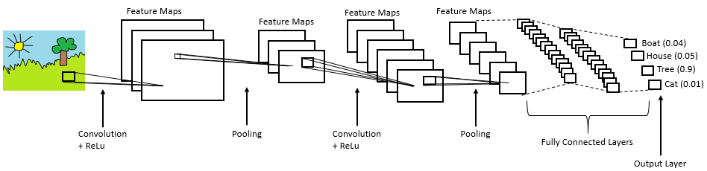

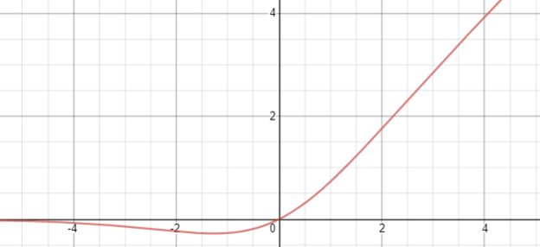
CNN model basics
Convolution layer
Pooling layer
Global pooling layer
Ways and observations to tune parameter
Number of Conv before Pool (1 or 2)
Number of features to extract (16, 32, 64, 128)
Activation function (ReLU, swish)
ReLU
swish

Slide 6
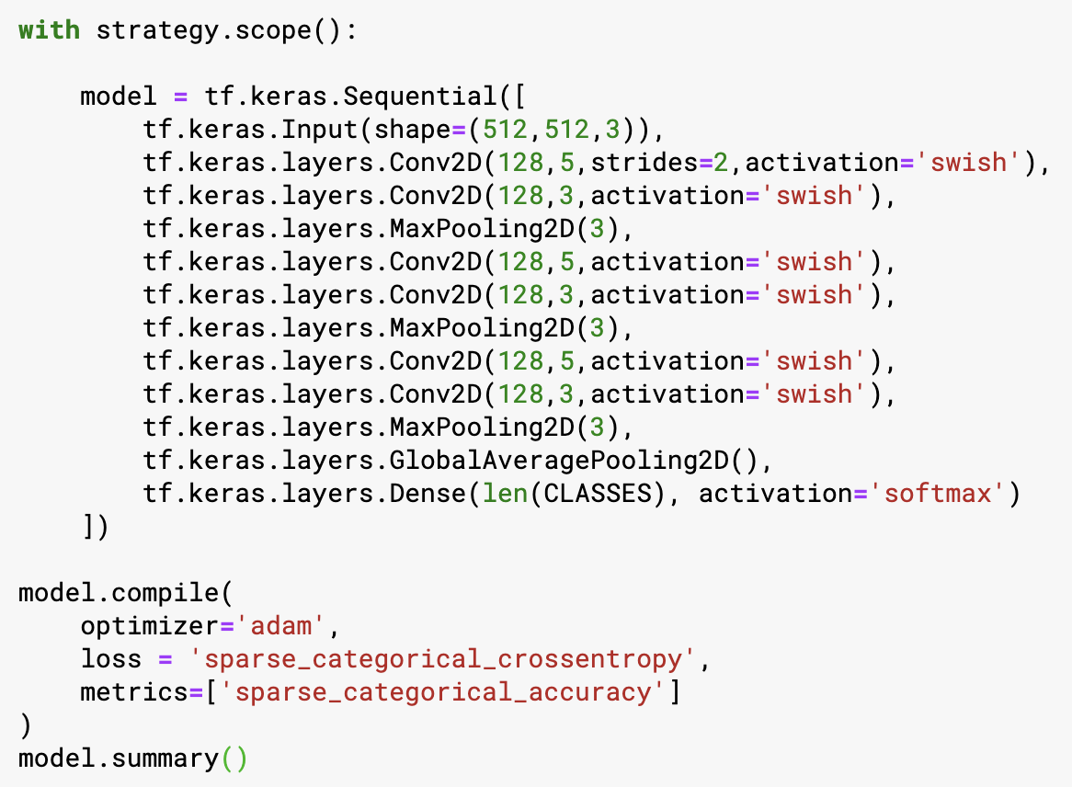
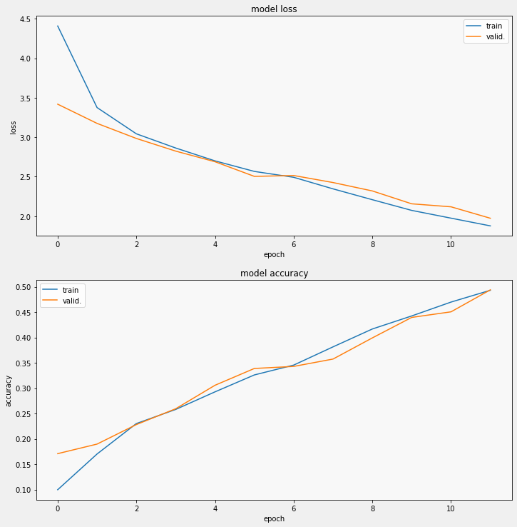
CNN model experiments
 | 16 | 32 | 64 | 128
2Conv2D+1MaxPooling2D+relu | 0.2985 | 0.2901 | 0.4278 | 0.4418
1Conv2D+1MaxPooling2D+relu | 0.2449 | 0.3454 | 0.3925 | 0.4825
2Conv2D+1MaxPooling2D+swish | 0.2578 | 0.3322 | 0.4230 | 0.4968
1Conv2D+1MaxPooling2D+swish | 0.2332 | 0.2955 | 0.4086 | 0.4434
We choose the modael with 2 Conv layers, 1 Maxpooling layers,
swish activation, and 128 features

Slide 7

Avoid Overfitting
Random dropout layer
Adding dropout slows down progress on training set
But decreases gap between training and validation set
Note: dropout layer only affects training, not val/test
 | Before: train-val | After: train-val
Accuracy of cnn model | 0.77 – 0.61 | 0.74 – 0.66

Slide 8
Transfer learning

Slide 9
1.Xception
2.VGG16
3.Densenet
4.Summary

Slide 10
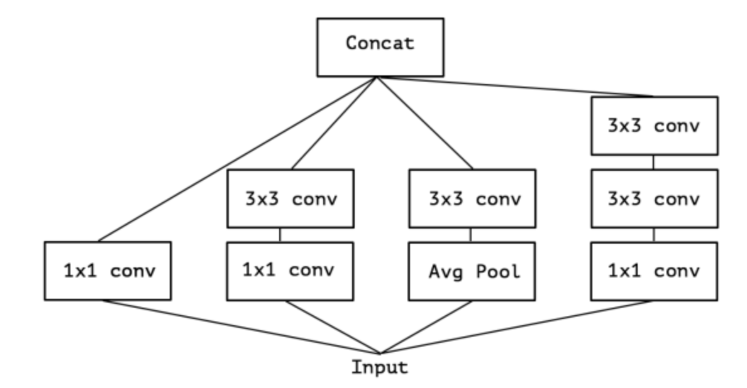
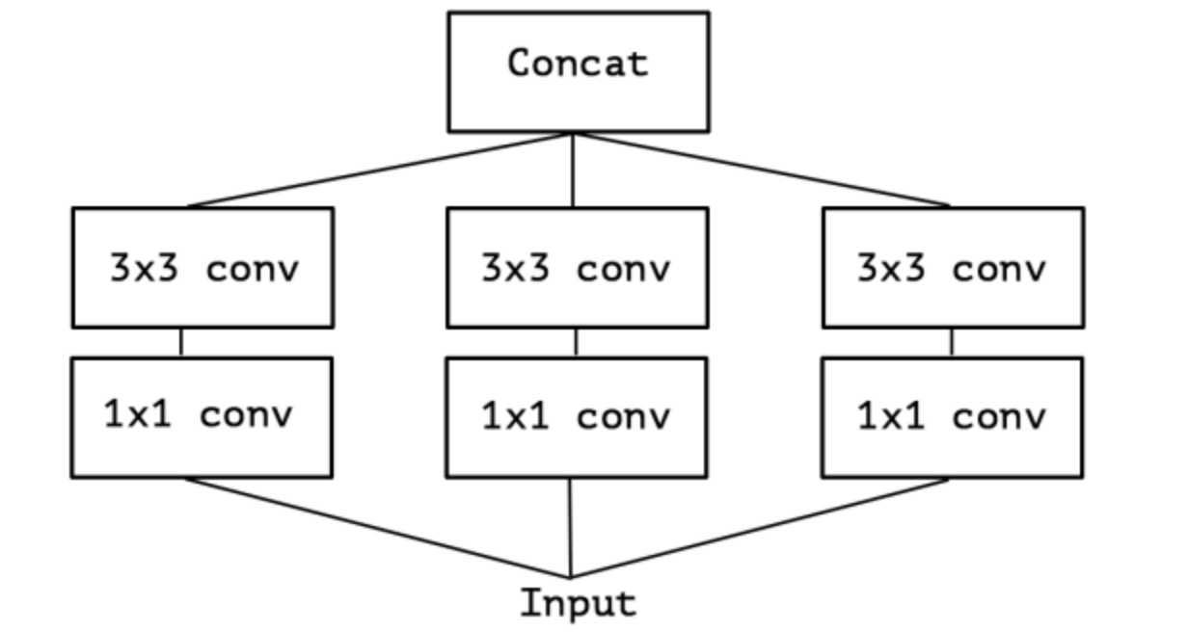
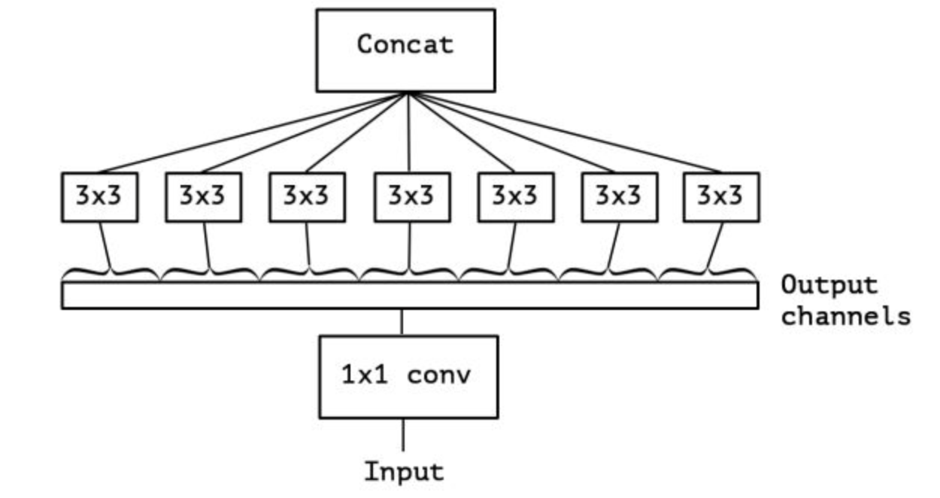
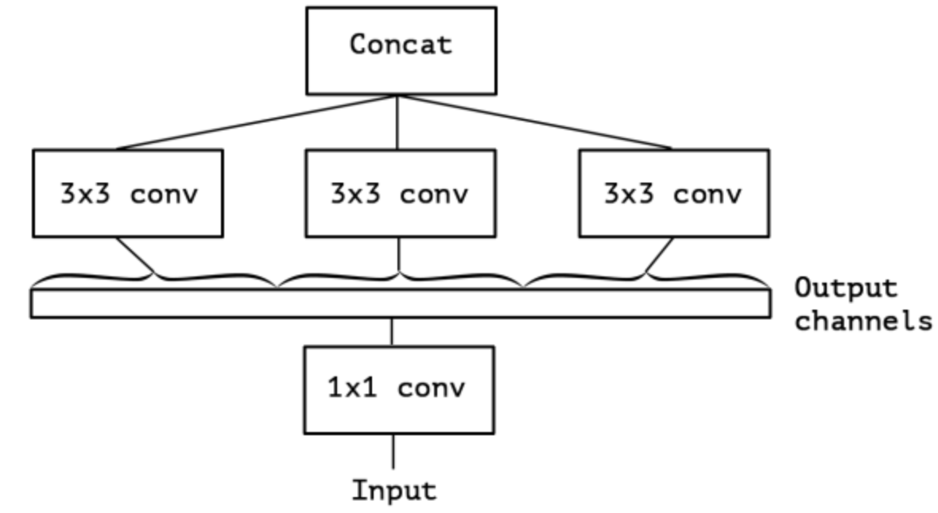
Inception v3
& Xception

Slide 11
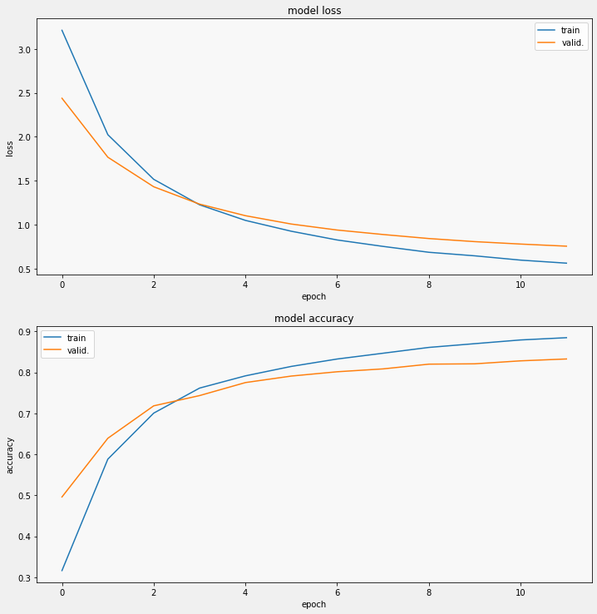
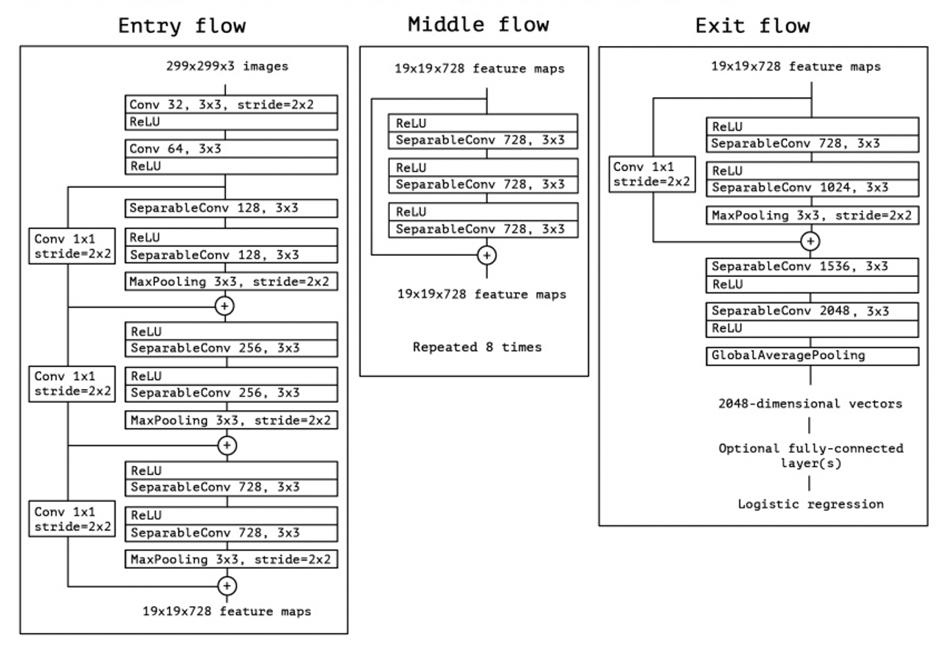
Xception
Train accuracy:0.8849; Train loss:0.5641
Valid accuracy:0.8330; Valid loss:0.7572

Slide 12
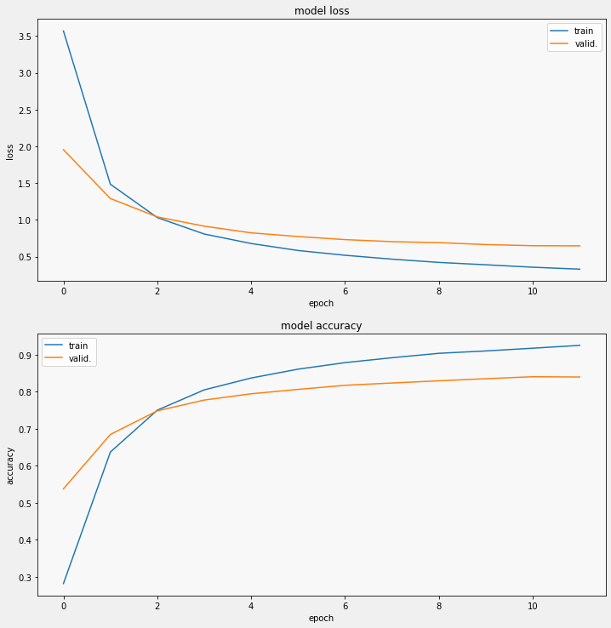
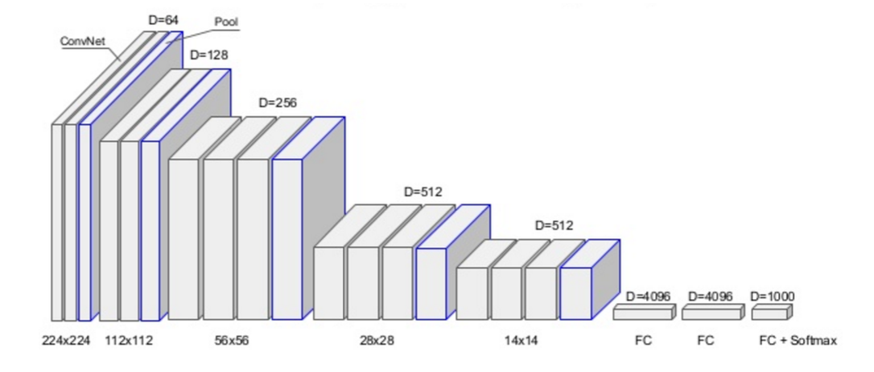
vgg16
Train accuracy: 0.9251; Train loss:0.3293
Valid accuracy: 0.8397; Valid loss:0.6467

Slide 13
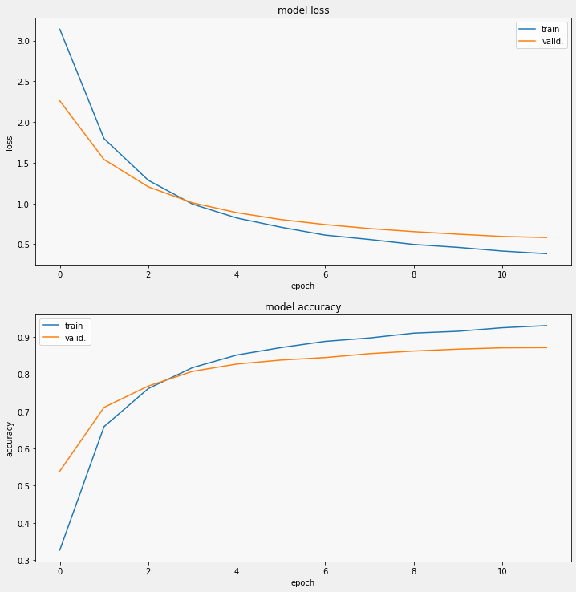
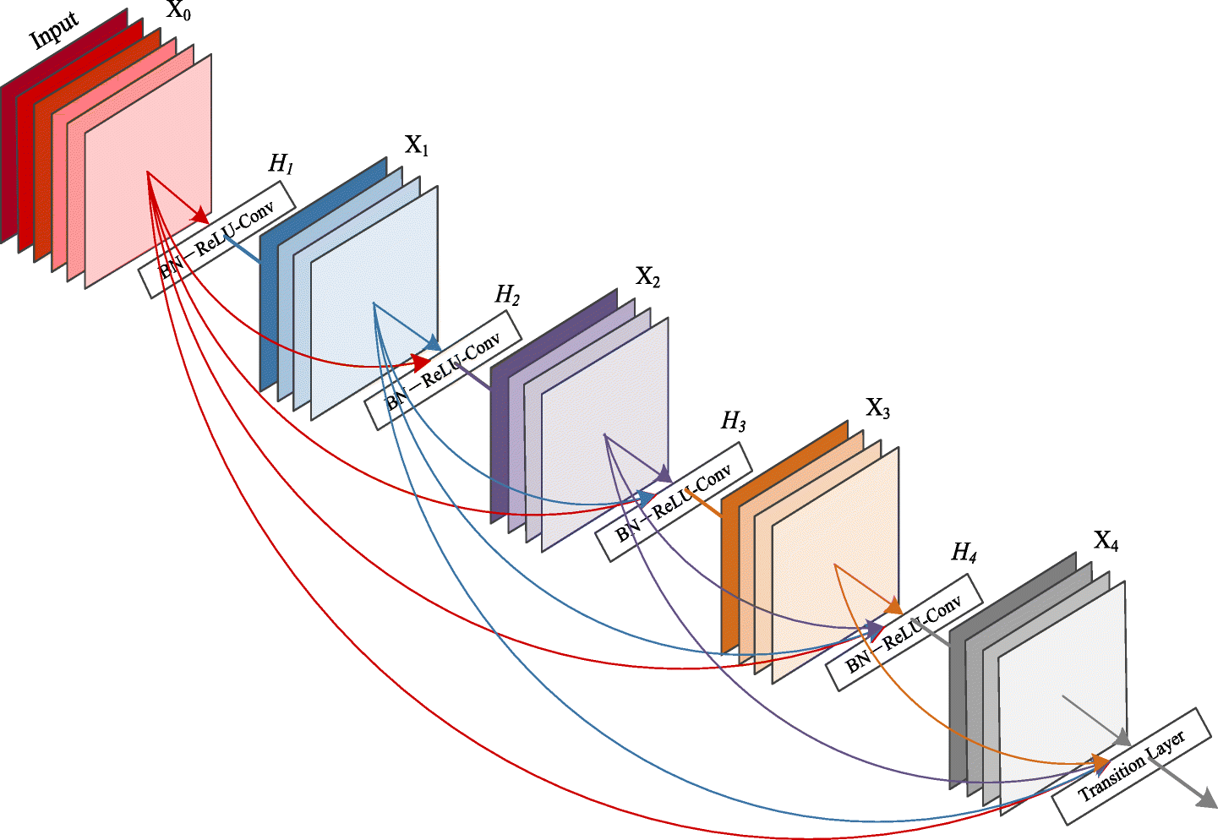
DenseNet
Train accuracy: 0.9311; Train loss:0.3836
Valid accuracy: 0.8718 ; Valid loss:0.5818

Slide 14
summary
Dropout layer is useful for VGG16, it can reduce overfitting, but for Xception and Densenet don’t seems to work.
It may be that VGG16 has a greater degree of overfitting.
Accuracy
 | train | valid | train_add_drop | valid_add_drop
Xception | 0.8849 | 0.8330 | 0.8880 | 0.8341
VGG16 | 0.9251 | 0.8397 | 0.9200 | 0.8510
Densenet | 0.9311 | 0.8718 | 0.9265 | 0.8728
Loss
 | train | valid | train_add_drop | valid_add_drop
Xception | 0.5641 | 0.7572 | 0.5660 | 0.7573
VGG16 | 0.3293 | 0.6467 | 0.3487 | 0.6266
Densenet | 0.3836 | 0.5818 | 0.3985 | 0.5828

Slide 15
Ensemble learning
Use several models that we have trained
Majority voting
Accuracy of each model: 0.83, 0.77, 0.84, 0.66
Accuracy after voting: 0.89

Slide 16
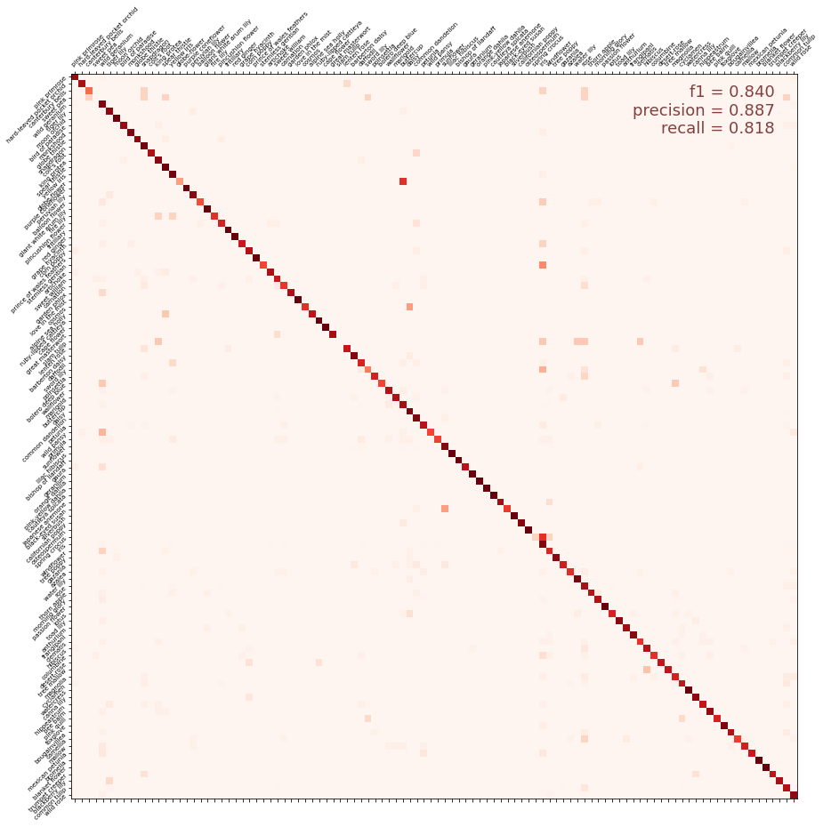
Confusion Matrix

Slide 17
Thnnk you

